Slide 1


Customers and product insight

Slide 2
NTRODUCTION
Before I walk through the dashboard, I want to share how I approach analysis. Whether it’s customer data or market data, my process stays the same. I look for the story the numbers are telling, and I focus on the movements that matter, the ones that break the pattern, the ones that need an explanation, and the ones that guide decisions.
In this presentation, I’ll walk you through the key patterns I identified, the behaviors they reveal, and how I translate those insights into practical guidance for product teams and clients. My goal isn’t just to show charts. It’s to show how I think, and how that thinking supports clear decisions, better onboarding, and stronger product adoption.

Slide 3
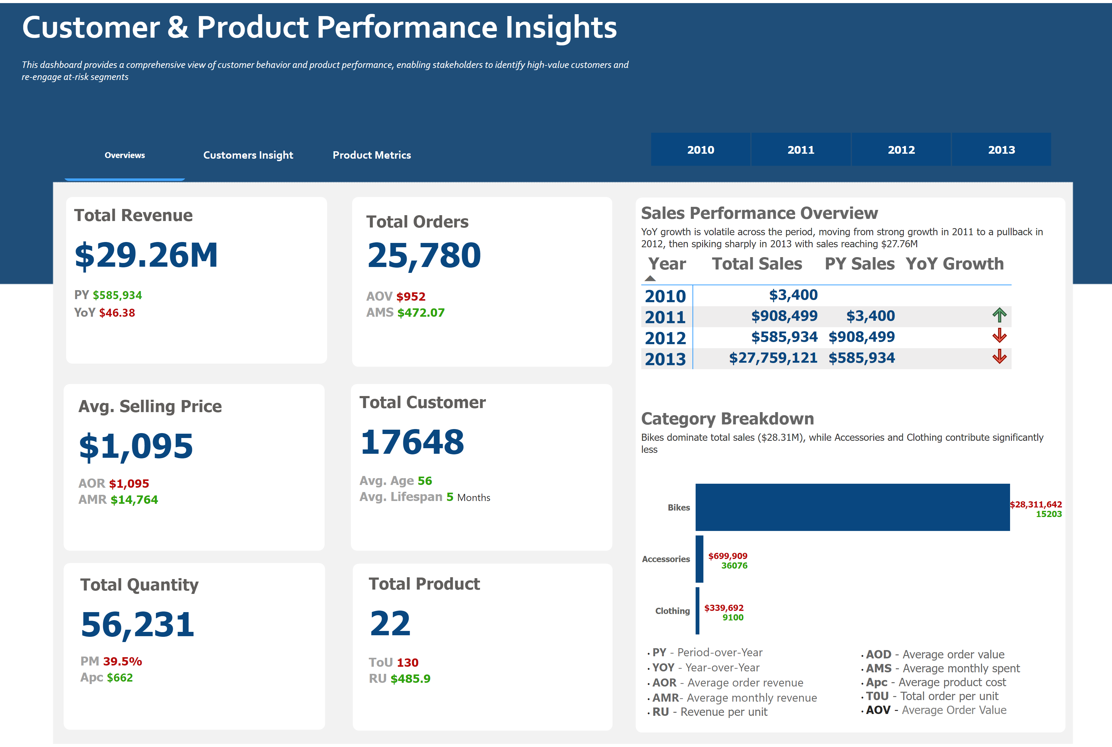
Revenue Trend Overview
What caused the sharp jump in 2013 and the drop in 2014?
I think about revenue the way I think about a live data feed. I look for stability and watch for anything that stands out. 2013 stands out right away because there’s a huge spike compared to earlier years. When I notice a change like that, my first step is to figure out what caused it. In a real market dataset, I would look for events, changes in structure, or data quality issues during that time. My main rule is simple: don’t guess what it means until you understand the movement
Notes:
I think about revenue the way I think about a live data feed. I look for stability and watch for anything that stands out. 2013 stands out right away because there’s a huge spike compared to earlier years. When I notice a change like that, my first step is to figure out what caused it. In a real market dataset, I would look for events, changes in structure, or data quality issues during that time. My main rule is simple: don’t guess what it means until you understand the movement

Slide 4
Category Breakdown
Why does one category carry almost the entire business?
Bikes dominate everything. More than $28M from one category. That’s concentration risk. If bikes slow down, everything slows down. Accessories and clothing barely move the needle. This kind of dependency is something I would surface early to a strategy team to avoid blind spots.
Notes:
Bikes dominate everything. More than $28M from one category. That’s concentration risk. If bikes slow down, everything slows down. Accessories and clothing barely move the needle. This kind of dependency is something I would surface early to a strategy team to avoid blind spots.

Slide 5
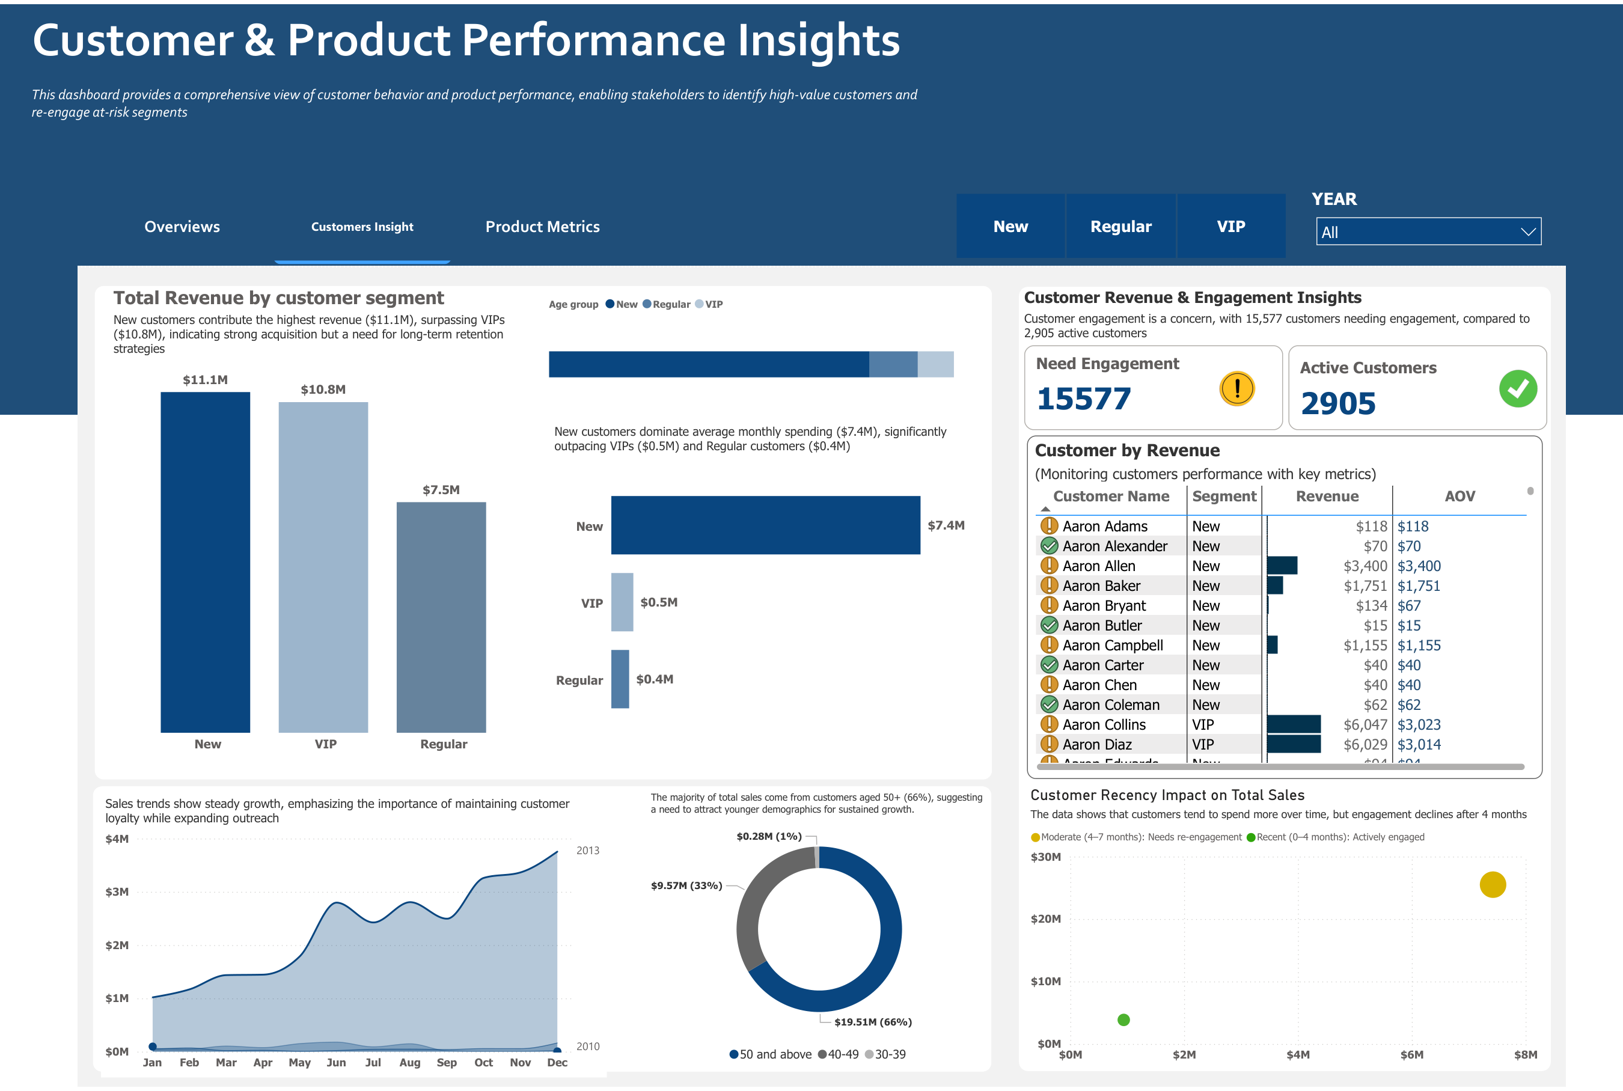
Customer Revenue by Segment
Why do new customers outperform VIP customers?
New customers bring in the highest revenue, even above VIPs. It tells me acquisition is strong, but long‑term retention is weak. If I was supporting a client on OneTick Cloud, this is the type of insight I’d surface immediately because it influences onboarding and engagement decisions.
Notes:
New customers bring in the highest revenue, even above VIPs. It tells me acquisition is strong, but long‑term retention is weak. If I was supporting a client on OneTick Cloud, this is the type of insight I’d surface immediately because it influences onboarding and engagement decisions.

Slide 6
Customer Engagement Insight
What does it mean when 15,000+ customers need engagement?
Only 2,905 customers are active, but more than 15,000 need engagement. That’s a major gap. In a market‑data context, this would feel like declining liquidity: fewer active participants, greater risk. It’s a signal worth watching closely.
Notes:
Only 2,905 customers are active, but more than 15,000 need engagement. That’s a major gap. In a market‑data context, this would feel like declining liquidity: fewer active participants, greater risk. It’s a signal worth watching closely.

Slide 7
Monthly Sales Trend
Why do sales spike consistently in December?
December peaks every year. It’s predictable, seasonal, and consistent. Time‑series patterns like this matter in forecasting and help prevent misinterpretation of expected spikes. It’s the same logic used when analyzing market cycles.
Notes:
December peaks every year. It’s predictable, seasonal, and consistent. Time‑series patterns like this matter in forecasting and help prevent misinterpretation of expected spikes. It’s the same logic used when analyzing market cycles.

Slide 8
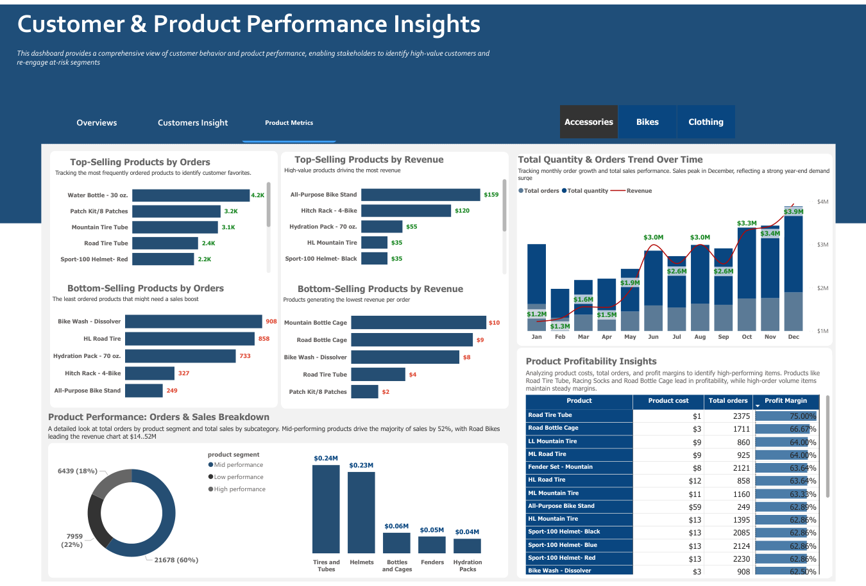
Top-Selling Products
What does it mean when low‑cost items dominate orders?
The most‑ordered products are low‑value items like bottles and tubes. This shows high‑frequency, low‑value buying behavior. In financial terms, this feels like a highly liquid asset: lots of activity at small amounts.
Notes:
The most‑ordered products are low‑value items like bottles and tubes. This shows high‑frequency, low‑value buying behavior. In financial terms, this feels like a highly liquid asset: lots of activity at small amounts.

Slide 9
Revenue Drivers
Which products bring real revenue, not just volume?
High‑value products drive your revenue, even though they aren’t ordered the most. That gives us two customer profiles: frequent spenders and high‑value buyers. It’s important for segmentation and pricing decisions.
Notes:
High‑value products drive your revenue, even though they aren’t ordered the most. That gives us two customer profiles: frequent spenders and high‑value buyers. It’s important for segmentation and pricing decisions.

Slide 10
Profitability Insights
Where does the business make profit most efficiently?
Tire tubes and bottle cages deliver strong margins. Even though they don’t generate the highest revenue, they are extremely efficient. This is the kind of insight that affects pricing, supply, and portfolio decisions.
Notes:
Tire tubes and bottle cages deliver strong margins. Even though they don’t generate the highest revenue, they are extremely efficient. This is the kind of insight that affects pricing, supply, and portfolio decisions.

Slide 11
Implications for OneMarketData
How does this analysis reflect the role I’m applying for?
My approach is simple: find patterns, validate anomalies, understand behavior, and turn numbers into decisions. This is exactly how I would support clients on OneTick — through clarity and insight.
Notes:
My approach is simple: find patterns, validate anomalies, understand behavior, and turn numbers into decisions. This is exactly how I would support clients on OneTick — through clarity and insight.

Slide 12
Closing Summary
What’s the simplest way to explain my approach?
Clarity matters. If I can explain a trend in one sentence, it means I understand it well. And when I understand it, I can help teams make better decisions. That’s the value I bring: clear thinking and client‑focused analysis.
Notes:
Clarity matters. If I can explain a trend in one sentence, it means I understand it well. And when I understand it, I can help teams make better decisions. That’s the value I bring: clear thinking and client‑focused analysis.

